Slide 1
Interview Skills

Slide 2
Interviews Skills
1. Interviewing skills for Managers
2. Interview skills for an employee

Slide 3
Purpose of an Interview
An interview is a two-way exchange, a conversation, in which both participants have some goals.
The Interviewer wants to determine:
Can the candidate do the job?
Will the candidate fit in?
Is this the best candidate for the position?
The Interviewee wants to determine:
Do I want this job?
Can I do this job?
Does this job offer me the opportunities I want for advancement or experience?

Slide 4
1. Interviewing Skills for Managers
Outline
Introduction
Preparing for the Interview
The Interview
Communicating effectively
After the interview

Slide 5
Interviewing Skills for Managers-Introduction
Job interviews are an essential part of making a sound hiring decision.
Why is interviewing so important?
After you have narrowed the talent pool based on your evaluation of the resumes you've received, it’s time to meet the most qualified applicants. Job interviews supply firsthand information about a candidate’s career, work experience and skill level. They also provide a general sense of overall intelligence, aptitude, enthusiasm and attitude — and how those attributes match up to the requirements of the job.
Finally, they offer insight into the candidate's basic personality traits, motivation to tackle the responsibilities of the job, desire to become a part of the company and ability to integrate into the current work team.

Slide 6
Interviewing Skills for Managers-Introduction
i. Prepare yourself for the Role:
Know what you are looking for in a candidate
Make sure that you have a detailed job description and person specification that sets out what you really want from the person.
Learn about the organization’s vision
The interviewer should carefully review the candidate's cover letter, resume, background information and references.
It is important to keep questions focused and relevant so they are tailored to individual job candidates
Ii. Skills required to be an interviewer:
Active listening
Verbal: Tone, clarity, volume, pitch
Non verbal communication skills

Slide 7
Interviewing Skills for Managers- Preparing for the Interview
The interviewing Panel
If you’re holding a panel interview, the panel needs to meet beforehand and discuss interview tactics.
Ideally, the interviewers (or panel) should carry out the short-listing for the interview, comparing the individual members’ scores for each candidate and agreeing on a panel score.
The panel then need to agree what questions should be asked and who is going to ask which questions, or cover which areas. It’s also helpful to discuss which areas are most important in case some areas have to be left unexamined.
Finally, the panel needs to agree what a ‘good’ answer to any particular question will look like, and how far they are prepared to probe to try to obtain one.

Slide 8
Interviewing Skills for Managers- Preparing for the Interview
ii. Your responsibilities before the Interview
Select the right job requirements
Develop structured interview questions
Craft useful rating scales
Assemble an effective hiring team
Arrange for a queit meeting place

Slide 9
Interviewing Skills for Managers- Preparing for the Interview
iii. Your responsibilities after the Interview
Let the interviewee ask questions
Calculate marks according to the rating scale
Ask for additional questions
Explain notification procedure
Give an expected start date for the job
Describe the next steps
Thank candidates for coming
Escort them to main reception area

Slide 10
Interviewing Skills for Managers- The Interview
Building Rapport with the Candidate
One interviewer will generally lead the interview, they should:
Introduce the members of the interview panel and outline the process of the interview.
Explain broadly what the interview is going to cover and who is going to ask questions. It is also useful to explain what other members of the panel will be doing: making notes, observing, or perhaps adding supplementary questions.
Start off the process with a simple question such as ‘Tell us what you do in your current job’.

Slide 11
Interviewing Skills for Managers- The Interview
Asking the Right questions
Interview questions generally take three forms:
experience- or competence-based questions
These questions are designed to explore what the candidate has done, and the skills that they have previously demonstrated. They take the form:
“Tell me about a time when you….”
“Can you tell me how you have gone about solving a particular problem that you have faced at work?”
These questions have one big drawback: they don’t explore potential. What a candidate has previously done may not translate to your organisation or your job.
If you are interviewing candidates who don’t have much work experience, it’s hard for them to demonstrate the skills from the past. It’s therefore also helpful to use a few hypothetical, or problem-solving questions.

Slide 12
Interviewing Skills for Managers- The Interview
ii. Hypothetical questions
These questions are designed to explore how candidates will deal with the problems that are likely to face them in this post. You may provide them with a written statement of the problem, perhaps as half a page of bullet points, or just outline it to them, and ask them to consider what they would do to address the problem.
Many interview processes use a candidate presentation to explore this area, for example asking candidates to present on what they see as the first five issues to be addressed in the job and how they would go about doing so.
iii. personal awareness questions
These questions are designed to explore the fit between the candidate’s needs and what the job or organisation can offer. For example, you might ask the candidate to tell you what motivates them, or what strengths they bring to the job. Good questions of this type ask the candidate to rank their requirements or strengths. This enables you to assess how personally aware they are, and also whether you can provide the necessary motivation and/or use their strengths.
“Please tell us, in descending order, the top five factors that keep you motivated on the job”
“Tell us the most effective ways of managing you”

Slide 13
Interviewing Skills for Managers- After the Interview
Being Fair and Transparent
Your final decision should be based on the scores you have given each candidate.
If, when you get to the end of the process, one or more interviewers feels that the ‘wrong’ candidate has emerged as successful then it’s helpful to examine why this is so. Have you missed a key job skill? Or was there something that they said which should have resulted in a lower score?
It’s fine to revisit the process and come up with a different answer, as long as you can justify it in the event of an appeal by the candidate. At this stage, the role of the independent assessor, if there is one, is to ensure that the process is fair to all candidates.

Slide 14
2. Interview Skills for an Employee
Interview = A meeting with an objective
Employer’s objective is to find the best person for the job
Employer: reviews candidate’s experience and abilities
Can you do the job? (skills, abilitie, qualifications)
Will you do the job? (interest, attitude & motivation)
How will you fit into the organisation? (personality)
You: impress employer and assess position on offer
What does this position offer me?
How does it fit with my career plans?

Slide 15
Preparation is the key to success
Review own skills, experiences and qualities
Check CV
Anticipate questions and identify relevant examples
Prepare key selling points
Research organisation
Websites, reports, articles, company literature, etc
Contacts with knowledge of organisation or sector
Relevant articles in the press
Personal visit or telephone call
Research job and occupational area
Job description – or similar
Current issues
Prepare your questions
Practice

Slide 16
Stages of an Interview
There are three stages:
Before the interview
During the interview
After the interview

Slide 17
Before the Interview
Read about the job/occupation.
Interview people in the department
Build your network
Practice interviewing
Dress for success
Visit the organization
Have an agenda, know what you want the interviewer to learn about you
Anticipate what questions will be asked
Know your Knowledge, Skills, Abilities and Accomplishments
Relate your KSAs to the position for which you are applying
Know who is interviewing you
Prepare and practice answers to typical questions

Slide 18
During the Interview
RELAX!
Answer the questions using the “PROVE IT” Method
Ask intelligent questions about the organization
Don’t volunteer negative information about yourself
Be honest
Have eye contact with the interviewer
Be believable, be yourself
Say positive things about your former supervisors and working conditions
Find ways to let the interviewer know you are a team player

Slide 19
After the Interview
Evaluate the interview
Write a thank you note to the interviewer
Follow up
Contact the interviewer for feedback
Express your interest in the position even after the position is filled

Slide 20
Watch the Body Language
First impressions very powerful
Allow time to relax
Dress appropriately
Entrance, introductions & handshake
Smile and make eye contact
Be aware of own movements
Watch body language of interviewer

Slide 21
Typical Questions
About you
Tell me about yourself - Bring me up to date with your CV?
Why did you choose that particular degree programme?
What experience have you had that is relevant to this post?
What would you consider your major achievements to date?
About the job
What interests you about this job?
What do you know about this organisation?
What other options are you considering?
How do you see your career developing – 5 years?
If you were Head of Department, what would be your priorities?
General knowledge
What do you think of the Government’s policy on college fees?
What’s your opinion of the Ryanair bid for Aer Lingus?

Slide 22
Other Type of Questions
“What if” Questions
No experience - how are you likely to respond to a situation
Probing Questions
How exactly did you deal with the situation?
How did you know it worked?
How did you feel about the outcome?
Could you have handled it differently?

Slide 23
Types of Interviews
Remote interviews
In-person interviews
Team interviews
Stress interviews
Case interviews
Competency Based interviews

Slide 24

1. Remote Interviews
A remote interview is typically done early in the interviewing process and it is typically a screening interview.
It might be over the phone, Skype, or video conference.
The primary objective of the screening interview is to remove you from active consideration before scheduling an in-person interview.
Common reasons for being weeded out at this stage include:
discrepancies between your resume and actual experience
poor verbal communication skills
or lack of the qualifications outlined in the organization's job description.

Slide 25

2. In-person interviews
The in-person interview is on-site at the company's location.
Panel
Team of people
Hiring Manager

Slide 26

3. Team interviews
A unique format for the in-person interview is the team interview, or panel interview. Typically you meet with a group of interviewers around a table in a conference room. Members of the interview panel may be from your prospective department or may be a cross-section of employees from throughout the company. One of the most important things to remember in an interview like this is to make eye contact with everyone on the panel, even when responding to a question posed by an individual panelist. Just take your time and treat every member of the team with the same respect you would the hiring manager.

Slide 27

4. Stress interviews
The interviewer snarls at you and asks you, so why the hell should I hire you for anything?
Welcome to the so-called stress interview.
The stress interview is a specific format designed to evaluate how you respond to hostility, how you respond to terrible conditions, high pressure stress.
Some companies use these interviews, these stress interviews to find out how you handle stress.

Slide 28

Stress Interviews...continued
You'll know you're facing a stress interview if you're facing several interviewers who glare at you, or who fire questions that are rude, rapid pace.
Or if you face an interview who ridicules everything you say or challenges every answer,
who stares out the window and seems to be completely uninterested in anything you have to say.
Those are deliberate tactics to subject you to stress.

Slide 29
Surviving stress interviews
Remain calm
keep a sense of humor
avoid getting angry or defensive.
It's a game to see if you will become depressed, hostile, or upset when facing adversity.

Slide 30

5. Case Interviews
A case interview is a job interview in which the applicant is presented with a challenging business scenario that he/she must investigate and propose a solution to.
Case interviews are designed to test the candidate's analytical skills and "soft" skills within a realistic business context.

Slide 31
6. Competency-based Interviews
Company identifies key skills required for job
Designs questions to elicit evidence of skills
Emphasis on past behaviour as predictor of success
Teamwork: Describe a team project you worked on. What problems arose? How did you deal with them?
Communication Skills: Describe situation when you had to persuade others to support your view. Give an example of any reports you’ve written which illustrate your writing skills
Interpersonal skills: What kinds of people do you find it difficult to work with? How do you handle those situations?
Taking Responsibility: Describe a time when you took responsibility to achieve a challenging goal
Problem-solving: Tell about a time when you had several tasks to manage at one time with conflicting deadlines.

Slide 32
Preparing for Competency Interview
Identify the competencies required for job
Review job description or ask for information
Define each competency in behavioural terms
Identify past experience to illustrate how you demonstrated that behaviour
Prepare examples for each competency
Practice talking about your experience
Try to give a complete answer - STAR

Slide 33
Responding to Competency Q
Q Give me an example of a problem you encountered. How did you approach it. What was the outcome?
STAR response
S: Describe the situation
T: Explain the task/problem that arose
A: What action did you take?
R: What was the result or outcome?
What did you learn from this experience?

Slide 34
Matching Skills to Requirements
Employer needs | Your evidence
Communication Team work Leadership Initiative Customer Care IT Commercial awareness | Presentation to class Example from Coop Class rep, Committee Fundraising for charity Working in Superquinn Designed website Business pages

Slide 35
Your Answers
Listen carefully, seek clarification
Illustrate answers with real examples and evidence
Be positive – constructive criticism
Keep answers specific and succinct
Take time to respond
Be alert to interviewer’s body language
Speak clearly, smile and show enthusiasm
Know what you want to say, and find the opportunity

Slide 36
Qualities Employers Seek
Good all-round intelligence
Enthusiasm, commitment and motivation
Good communication skills
Team work ability
Ability to solve problems
Capacity to work hard
Initiative and self-reliance
Balanced personality

Slide 37
Competencies required by X Company
Adaptability
Integrity
Innovation
Teamwork
Initiative
Drive for Results
Know the Business
Open Exchange of Information
Makes Difficult Decisions

Slide 38
Your Questions
Training programmes
Career development opportunities
Types of projects & responsibilities
Reporting structure
Performance appraisal
Profile of staff
Questions about topics raised in interview
What happens next?

Slide 39
What creates a bad impression
Poor personal appearance
Negative attitude – evasive, using excuses
Lack of interest and enthusiasm
Lack of preparation
Poor knowledge of role
Failure to give concrete examples of skills
Over emphasis on money/rewards
Lack of career plan

Slide 40
ESTABLISHING THE FIRST GREAT IMPRESSION
To make a great first impression, use your EMPATHY skills.
But what is empathetic and what does it mean to have empathy skills?
The best answer comes from Dr. Helen Riese, who teaches empathy at the Harvard Medical School.

Slide 41
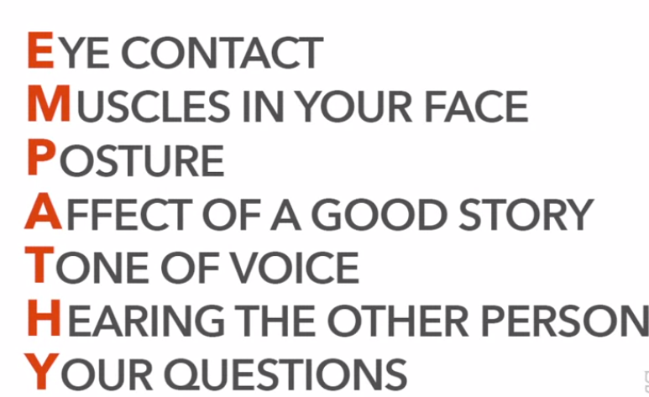
EMPATHY

Slide 42
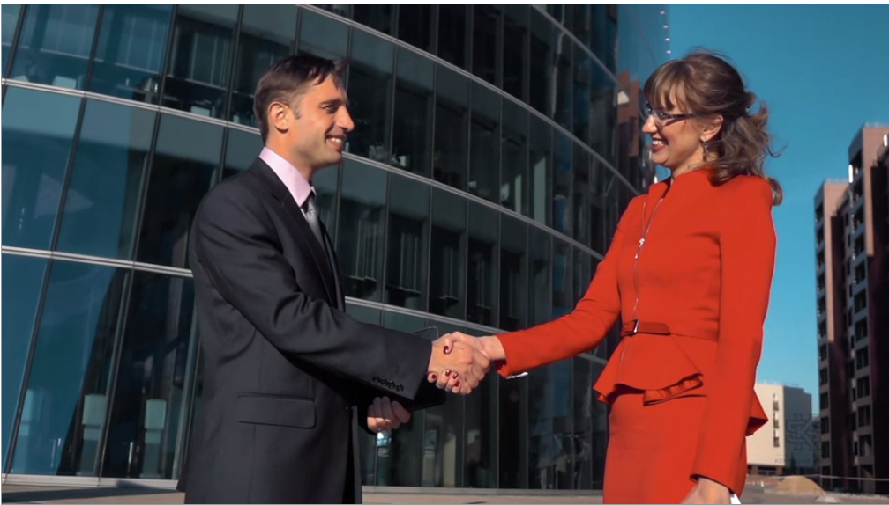
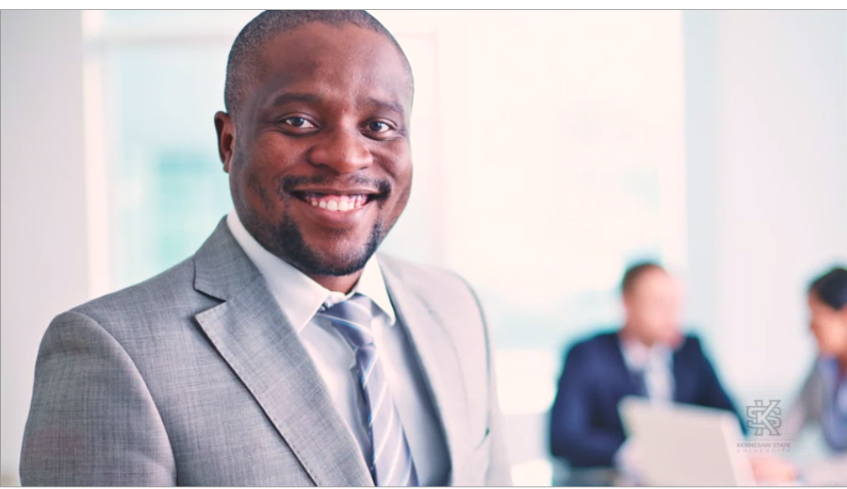
E-EYE-CONTACT
All human beings have the innate desire to be seen.
So it's very important to make good eye contact with the people we meet, especially the people we meet during the job interview process.
We definitely need to make good eye contact when we offer a person a firm handshake.

Slide 43
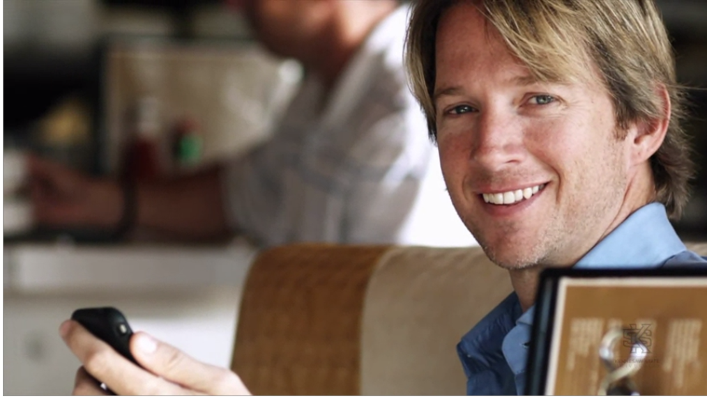
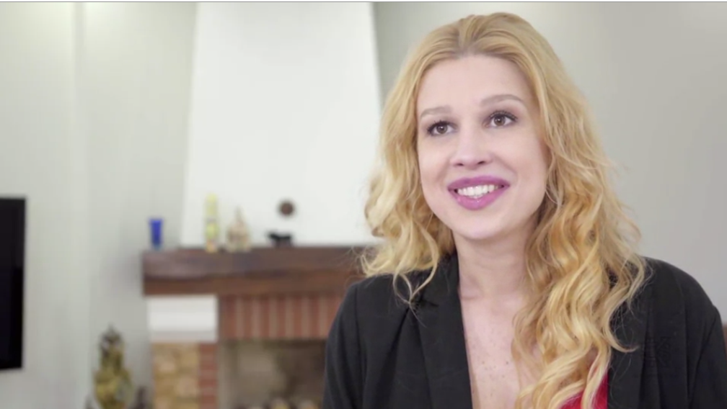
M-MUSCLES IN YOUR FACE
The M stands for the muscles in our face.
A person can learn a lot about us by watching our facial expressions.
During a job interview, we need to be upbeat, interested and interesting and likable.
It begins with our smile.

Slide 44


P-POSTURE
The P stands for posture.
This behavior includes the body posture, our hand gestures, eye movement and the use of space.

Slide 45


A-AFFECT OF A GOOD STORY
The A stands for the effect a good story has on another person.
Stories are a universal language of thoughts.
We all appreciate a good story, one where we can share feelings of joy or hope or conquering a challenge.
Sharing a good story can give even the most averse people a sense of commonality and community.

Slide 46

T-TONE OF VOICE
The T stands for tone of voice.
It's our tone of voice that tells others how we feel about our message, and it will influence how they will feel about our message.
We need to speak at the right pitch, at the right speed for the situation.
When we're in front of a big crowd, we need to be proud and loud.
Don't be afraid to speak up.

Slide 47
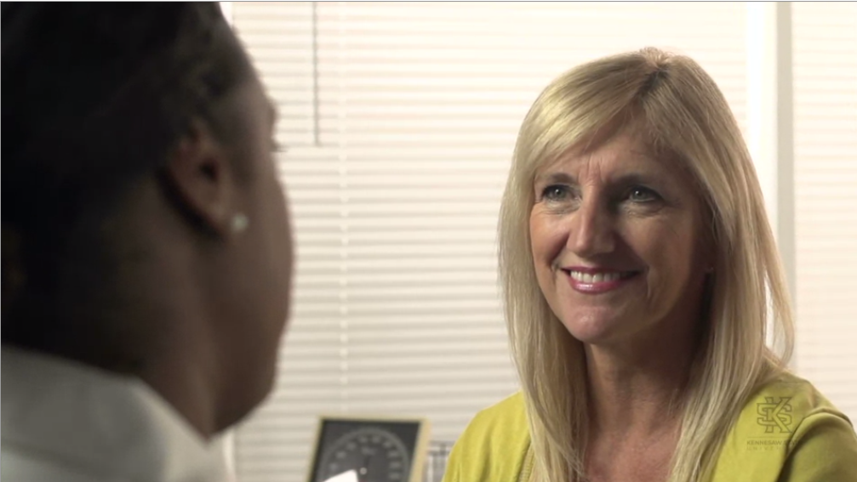
H-HEARING THE OTHER PERSON
The H stands for hearing the other person.
Listening is one of the most important skills we can have in life, both at work and at home.
We probably spend more time using our listening skills than any other kind of skill.
Like other skills, listening takes practice.
We need to both hear and understand the other person.

Slide 48

Y-YOUR QUESTIONS
If we want to make a big first impression, we need to ask quick questions too.
But we don't want to ask too many questions that can be sometimes annoying.
Arrive at the interview with three questions that we want to ask.
For example, a good question might be, I see that your company has five core values and then you would repeat those values to them. As you look at the company's future, which core value do you think is most important?

Slide 49

PROMOTE YOURSELF WITHOUT SELLING OUT
Four Components to Promote Yourself
Know your intentions
Promote what you believe in and own it
State the Value Proposition First
Be Yourself

Slide 50
1. Know your intentions
Knowing yourself, your intentions, what you want and don’t want, and what you will and will not share is as important in shaping how you promote yourself as is what you promote.
You need to go into any opportunity with the end in mind.
But….be cognizant of the difference between self-promotion and shameless self-promotion.
It’s the difference between promoting “me” and promoting “we”.

Slide 51

2. Promote what you believe in and own it
While you certainly are expected to introduce yourself, it’s your ideas and solutions that will reflect well upon you.
Share examples, show your passion, translate the difference you have made, and most importantly focus on for whom.
When you let people know what you stand for, what you believe in, and how you can improve conditions associated with your beliefs, you are sharing authenticity.

Slide 52

3. State the Value Proposition First
The value proposition, also called the “what’s in it for me” proposition, is something we all need to consider when self-promoting.
Your audience, your listener, is listening out of more than simply courtesy.
They’re listening for solutions to their problems, for benefits to their organization, and/or for truly interesting information that adds value to their knowledge base.
They are not listening to simply allow you to state fact after fact, accomplishment after accomplishment, or skill after skill. Boring……and also somewhat obnoxious.
They are listening for the value proposition. So, start with it first. Snag their interest.

Slide 53

4. Be Yourself
We’ve often heard the saying, “fake it ‘till you make it”.
But its purpose is to solve a problem temporarily.
It is not a standard way of being or connecting with people.
When you are self-promoting, the person you are promoting needs to actually be who you are…not a manifestation of who you’d like to be or believe you should be.
If you’re not naturally loud and outgoing, don’t try to be. Quiet is just as good.

Slide 54
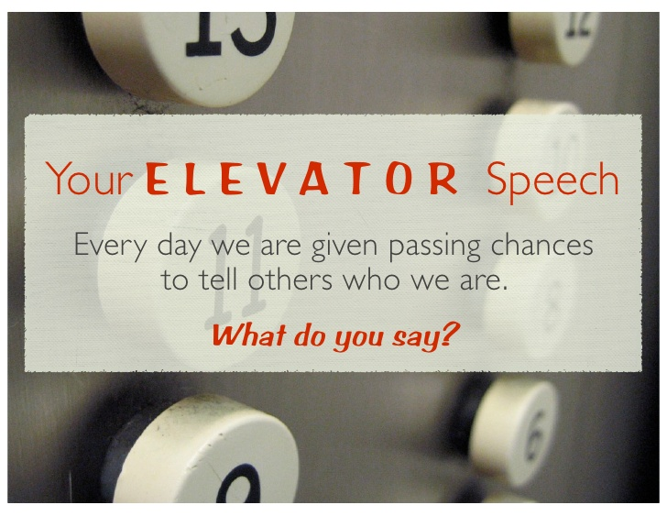
The 30 Second Elevator Speech
An elevator speech is a clear, brief message or “commercial” about you. It communicates who you are, what you’re looking for and how you can benefit a company or organization.
It’s typically about 30 seconds, the time it takes people to ride from the top to the bottom of a building in an elevator.
The idea behind having an elevator speech is that you are prepared to share this information with anyone, at any time, even in a short elevator ride.

Slide 55
Continued..
It is important to have your speech memorized and practiced, as this is really just about you!
No one knows you better than you do. Your elevator speech needs to sound natural, flow quickly, and leave the person you just spoke to with a clear understanding of who you are, what you can do, and what you would like their assistance with.

Slide 56
AN ELEVATOR SPEECH OUTLINE
Most Important 10 points:
ABOUT YOU
1. Smile to your counterpart, and open with a statement or question that grabs attention: a hook that
prompt your listener to ask questions.
2. Tell who you are: describe you, and if you are currently working, your company.
3. Tell what you do and show enthusiasm.
WHAT DO YOU OFFER
4. Tell what problems have solved or contributions you have made.
5. Offer a vivid example.
6. Tell why you are interested in your listener.
WHAT ARE THE BENEFITS
7. Tell what very special service, product or solutions you can offer him or her.
8. What are the advantages of working with you? How or in what ways do you differ from others?
HOW DO YOU DO IT
9. Give a concrete example or tell a short story, show your uniqueness and provide illustrations on how
you work.
CALL FOR ACTION
10. What is the most wanted response after your elevator speech? Do you want a business card, a
referral or an appointment for a presentation after your elevator speech?

Slide 57
WORD LIMIT OF ELEVATOR SPEECH
The elevator speech is:
absolutely not longer than 25 to 30 seconds
or - in words - approximately 80 to 90 words
or - in sentences- 8 to 10 sentences

Slide 58
Tips
Rehearse your 30 second elevator speech with a friend or in front of a mirror.
The important thing is to practice it OUT LOUD.
You want it to sound natural.
Get comfortable with what you have to say so you can breeze through it when the time comes.

Slide 59
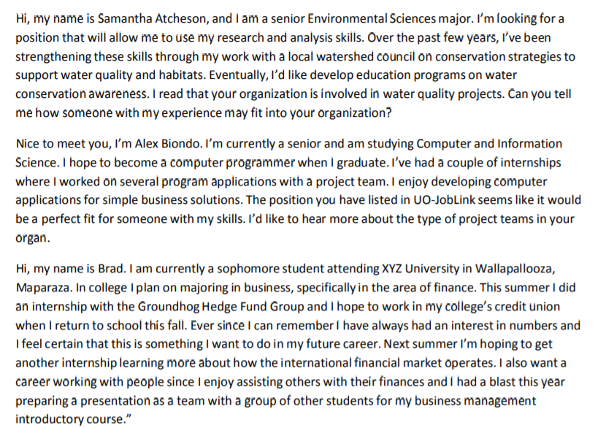
Examples of Elevator Speech-University Students

Slide 60
TOP 10 MOST WANTED SKILLS IN INTERVIEW
10. Problem Solving Skills: Employers want to know you can make decisions. You can solve problems.
9. Planning and Organization: You know how to plan and organize your time. Managers want to know you can set goals and reach them.
8. Flexibility and Adaptability: Organizations expect you to be flexible and adaptable. You can manage multiple assignments and tasks, you can set priorities, you can adapt to changing conditions, and work assignments.
7. Interpersonal Skills: You have good interpersonal skills, you have a high emotional IQ, you know how to get along with others, and minimize conflict. Employers want to know you can relate to other people and cultures with sensitivity and awareness.
6. Strength of Character: you are honest, you have integrity, loyalty, strength of character. Your supervisor certainly expects you to be trustworthy and honest.

Slide 61
TOP 10 MOST WANTED SKILLS IN INTERVIEW
5. Technical Skills: you have the skills you need to actually perform your work. Firms want you to know you have the skill set to do the job, of course. But that's not all.
4. Teamwork: You can work confidently within a group., You let your voice be heard and respect what others have to say. Because so many jobs involve working in groups, employers want you to be able to work well with others. To fit in with the team.
3. Self-Motivation: You are a self motivated person, you take initiative, you work hard. Organizations don't want people who always have to be told what to do. They want you to take responsibility for your work.
2. Evolutionary Skills: You know how to learn, and how to continually improve. Every potential employer wants to know you can grow and evolve in your work. And now the number one skill that employers are looking for.
1. Communication Skills: you are a clear, concise, and effective communicator. Employers want you to be able to speak and listen effectively.

Slide 62
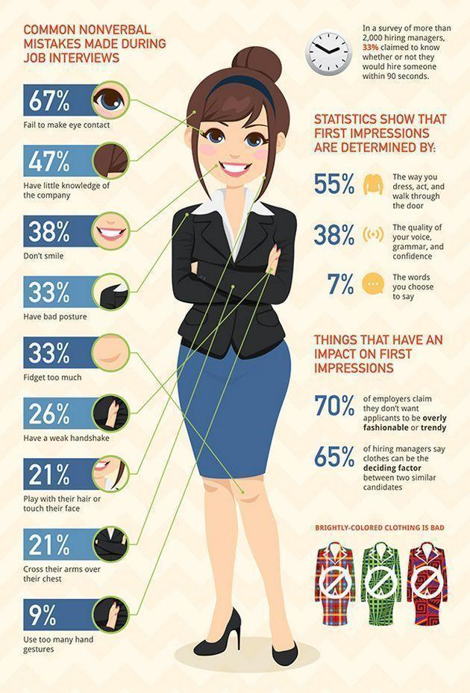

Slide 63
10 Tough Interview Questions and Ten Great Answers
Visit the following link:
https://collegegrad.com/mastering-the-interview/ten-tough-interview-questions-and-ten-great-answers

